Slide 1
Processes_and_Processors_in_DS
Lecture-21

Slide 2
Introduction
Processes:
Definition: A process is an instance of a program in execution. It is an active entity, with a program counter specifying the next instruction to execute and a set of associated resources (such as memory, files, and I/O devices).
Characteristics:
Has its own memory space.
Can communicate with other processes via Inter-Process Communication (IPC) mechanisms like pipes, shared memory, message queues, etc.
More overhead due to context switching.

Slide 3
Cont..
Threads:
Definition: A thread is the smallest unit of execution within a process. Multiple threads can exist within the same process, sharing the same memory space.
Characteristics:
Share the same memory space and resources of the process.
More efficient than processes due to lower context-switching overhead.
Easier and more efficient for communication within the same process.

Slide 4
Cont..
Why Use Processes?
Isolation: Processes are isolated from each other, providing better fault tolerance and security.
Resource Management: Suitable for tasks that require a dedicated amount of resources.
Why Use Threads?
Efficiency: Threads are lightweight compared to processes, allowing faster creation, termination, and context switching.
Shared Memory: Easier communication and data sharing since threads within the same process share memory.
Concurrency: Useful for performing multiple operations concurrently within the same application.

Slide 5
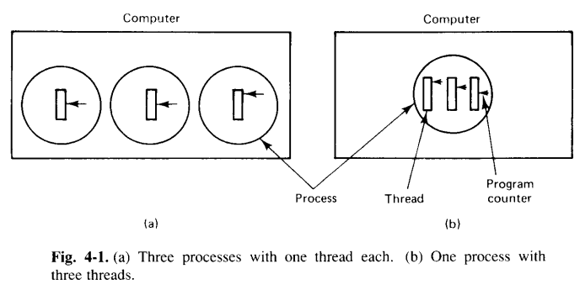
Introduction to Threads
In Fig. 4-1(a), we see a machine with three processes.
Each process has its own program counter, its own stack, its own register set, and its own address space.
The processes can communicate through the system’s inter process communication primitives, such as semaphores, monitors, or messages passing.

Slide 6
Cont..
In Fig. 4-1(b), we see another machine with one process.
Only this process contains multiple threads of control just called threads, or sometimes lightweight processes.
In many respects, threads are like little mini-processes.
Each thread runs strictly sequentially and has its own program counter and stack to keep track of where it is.
Threads share the CPU just as processes do: first one thread runs, then another does (time sharing).
Only on a multiprocessor do they actually run in parallel.
Threads can create child threads and can block waiting for system calls to complete, just like regular processes.
While a thread is blocked another thread in the same process can run, in exactly the same way that when one process blocks, another process in the same machine can run.
All threads have exactly the same address space.

Slide 7
Cont..
Like traditional processes (i.e., processes with only one thread), threads can be in any one of several states: running, blocked, ready, or terminated.
Running thread currently has the CPU and is active.
A blocked thread is waiting for another thread to unblock it.
A ready thread is scheduled to run, and will as soon as its turn comes up.
Finally terminated thread is one that has exited, but which has not yet been collected by its parent.
Thread Usage:
Threads were invented to allow parallelism to be combined with sequential execution and blocking system calls.
In Fig. 4-3(a), the dispatcher reads incoming requests for work from the system mailbox.
After examining the request, it chooses an idle (i.e., blocked) worker thread and hands it the request.

Slide 8
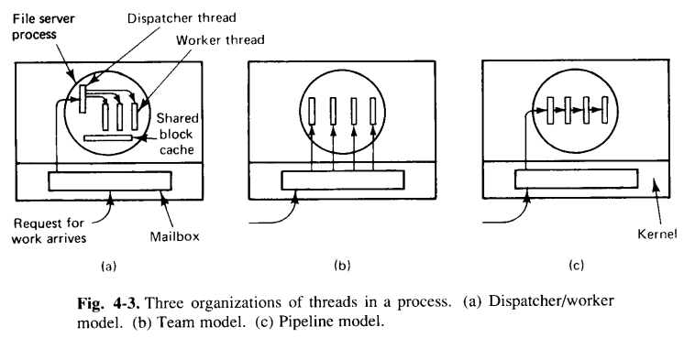
Cont..
The dispatcher then wakes up the sleeping worker.
When the worker wakes up, it checks to see if the request can be satisfied from the shared block cache, to which all threads have access.
If not, it sends a message to the disk to get the needed block and goes to sleep, awaiting completion of the disk operation.

Slide 9
Cont..
The team model of Fig. 4-3(b) is also a way to organize a multithreaded process.
Here all the threads are equals, and each gets and processes its own request.
There is no dispatcher.
Sometimes work comes in that a thread cannot handle, especially if each thread is specialised to handle a particular kind of work.
In this case, a job queue can be maintained, with pending work kept in the job queue.
With this organization, a thread should check the job queue before looking in the system mailbox.
Threads can also be organized in the pipeline model as shown in Fig. 4-3(c).
In this model, the first thread generates some data and passes them on to the next thread for processing.
The data continues from thread to thread, with processing going on at each step.

Slide 10
Implimenting Threads in User Space
In this scheme, we put the thread package entirely in the user space.
User space means that the operating system (OS) is not directly involved in managing the threads.
Instead, the threads are controlled by a user-level library.
The OS only sees one process, and it doesn't know how many threads are running inside that process.
Thread switching (moving from one thread to another) is very fast because the OS is not involved. The thread library manages everything.
Pros:
Fast switching: Because the OS is not involved, threads can quickly switch between tasks.
Custom scheduling: The user-level library can decide how to schedule threads based on specific needs.
Cons:
No OS help: If one thread is blocked (like waiting for input), the entire process is blocked because the OS doesn't know that there are multiple threads inside.

Slide 11
Implementing Threads in Kernel Space
In kernel space, the OS directly manages the threads. The OS knows about all the threads and controls how they run.
Thread switching is slower because the OS is involved and has to manage each switching, but the OS can handle more advanced scheduling, like prioritizing important tasks or handling blocked threads.
Pros:
Better control: The OS can manage all threads and make decisions like prioritizing important threads or helping blocked threads.
Handles blocking: If one thread is blocked, the OS can still run other threads.
Cons:
Slower switching: Involving the OS makes switching between threads slower than in user space.

Slide 12
Scheduler Activation and Upcalls
Scheduler Activation:
This is a hybrid model that combines the best of both user and kernel space threading. The OS and the user-level thread library work together to manage threads.
The kernel manages resources like the number of CPUs or cores.
The user-level library manages the threads inside the process and decides how to switch between them.
Upcall:
An upcall is a notification from the OS (kernel) to the user-level thread library.
It tells the library when more resources (like CPUs) become available or when certain events happen, like a thread becoming unblocked.
Benefits:
Fast switching like in user space with the OS's help in managing resources.
The OS can provide more resources when needed, and the user-level library can decide how to use them.

